Slide 1
Development
September 2025

Slide 2
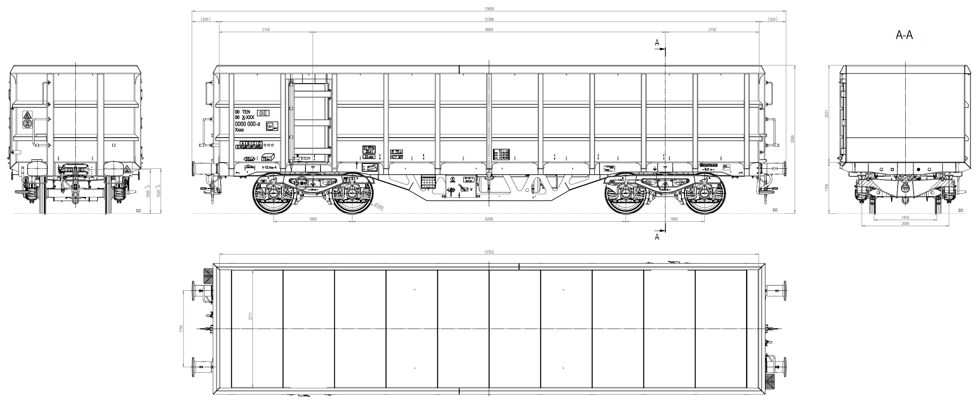
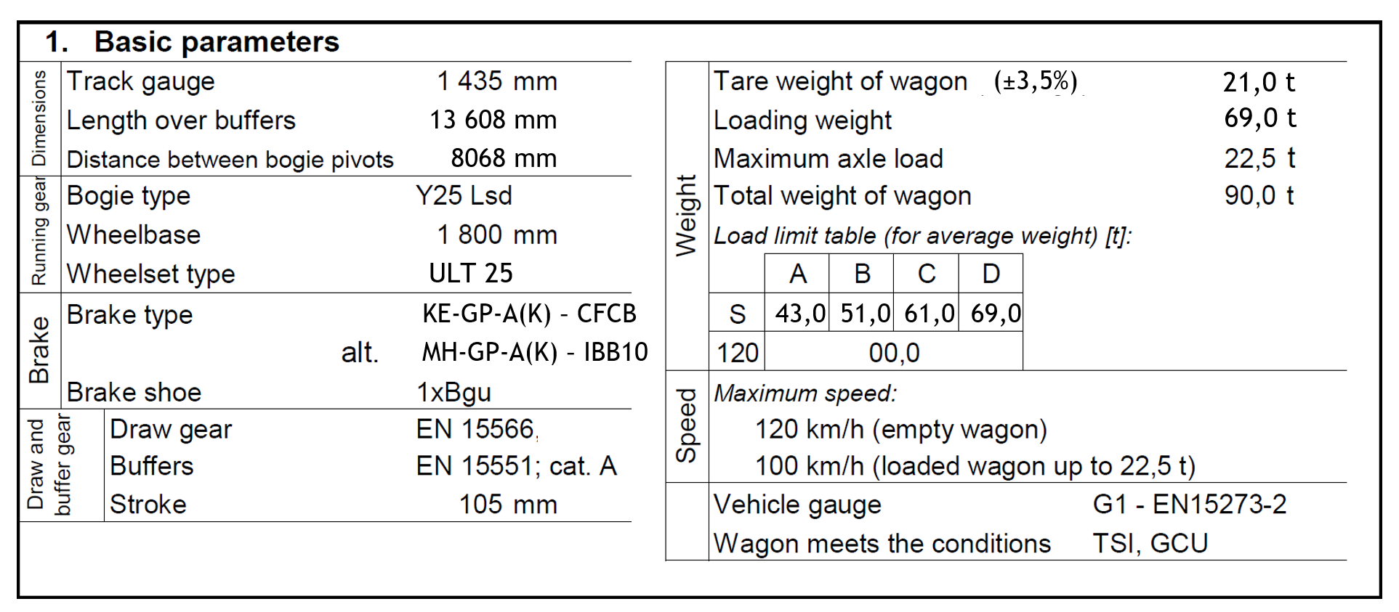
TransANT UNO Multi 40ft

Slide 3
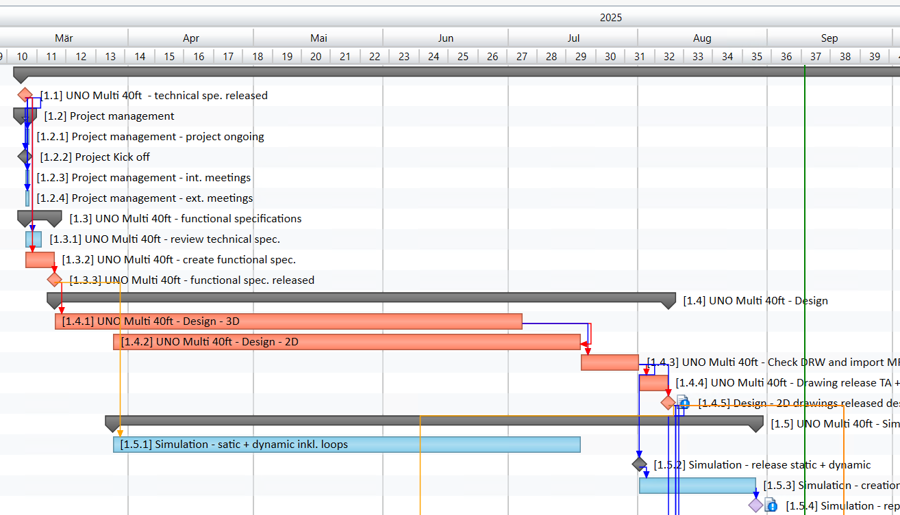
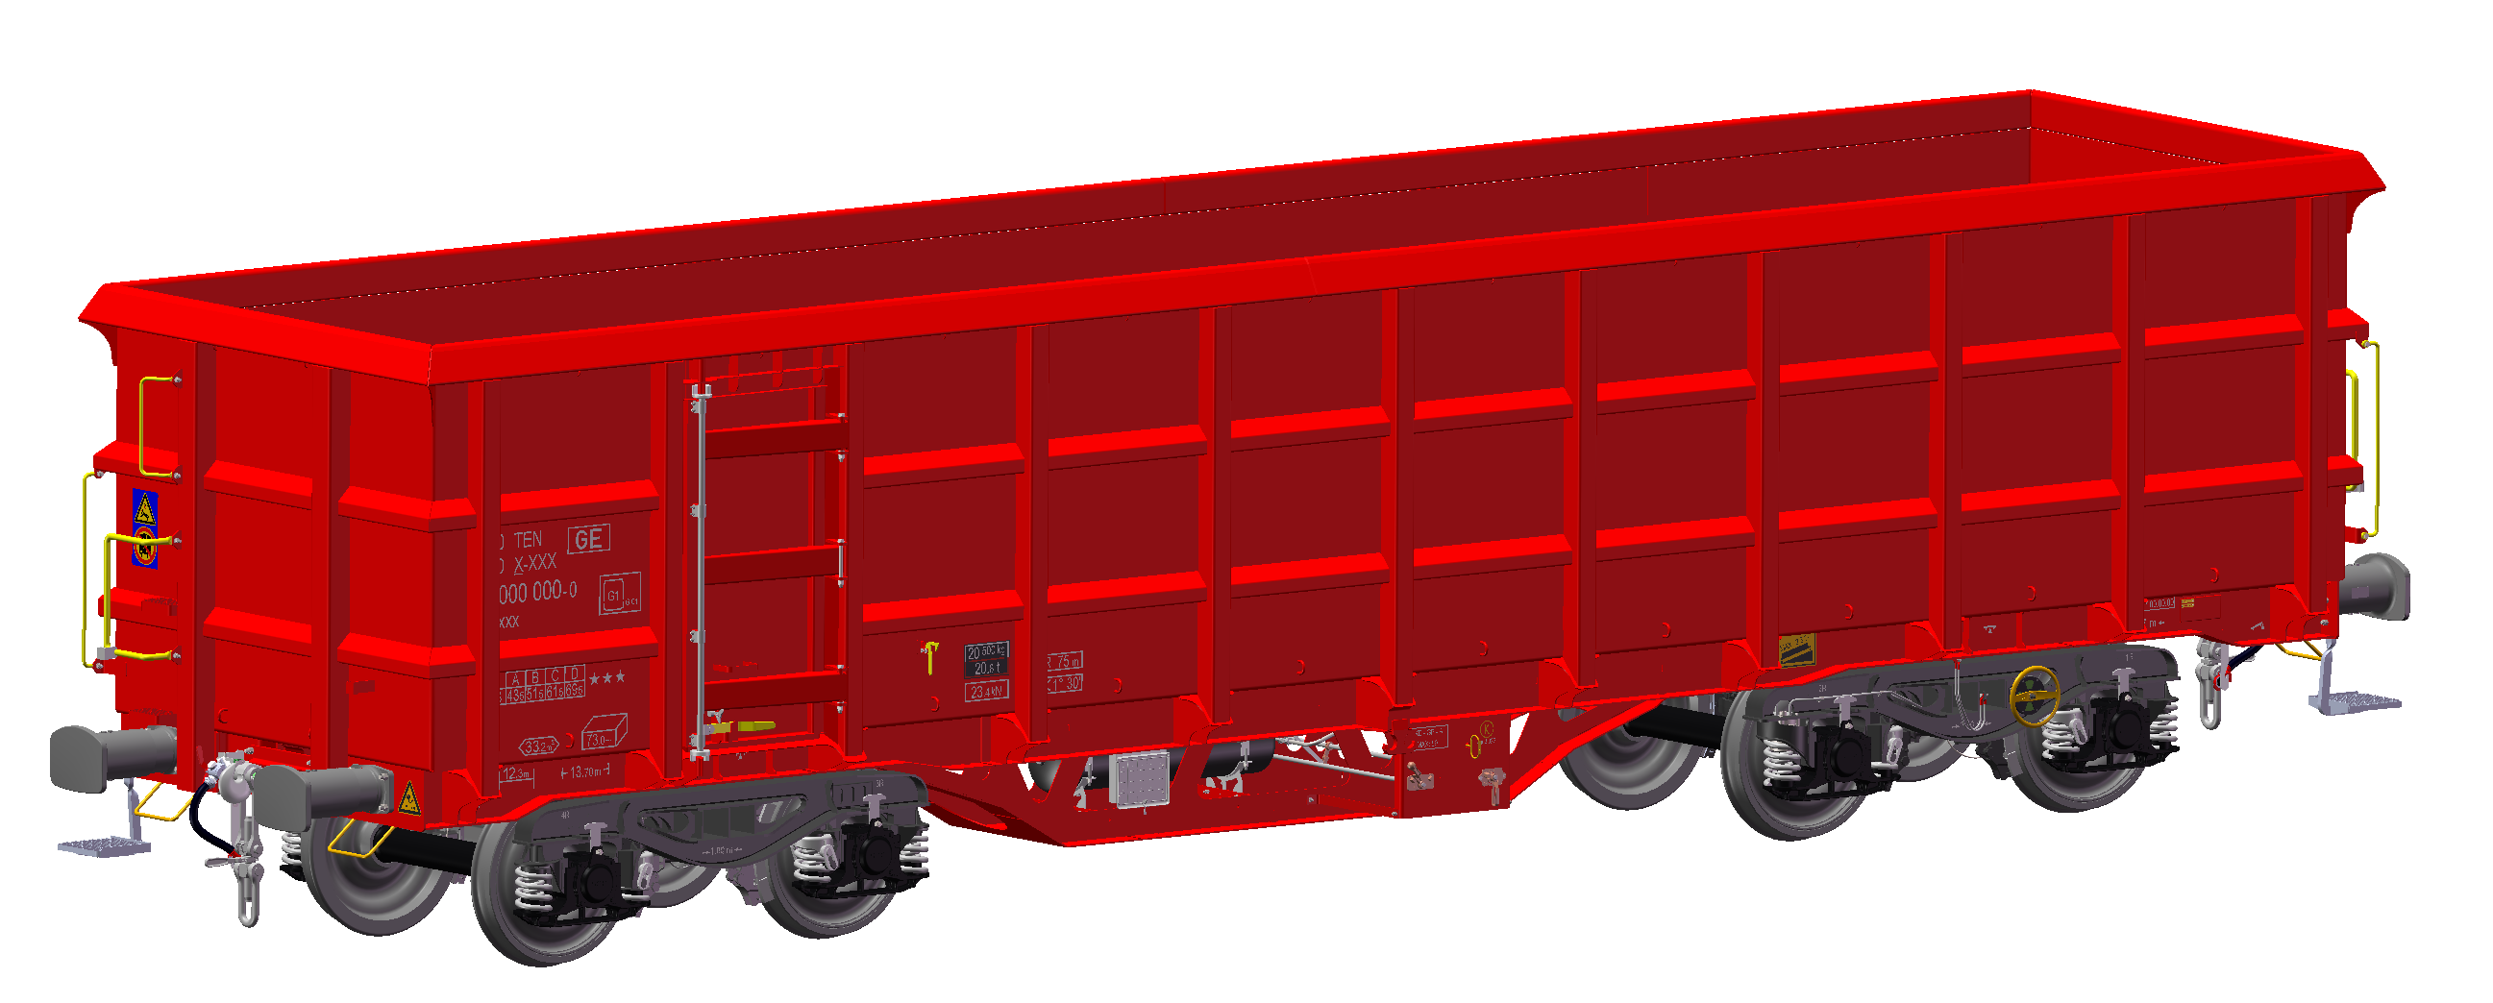
Current status - TransANT UNO Multi 40ft
Drawing set in status “Freigabe DVM” → ready for approval by DVM
Calculation (static + dynamic) completed
Calculation report completed
waiting for approval by DVM to finish drawing release process

Slide 4
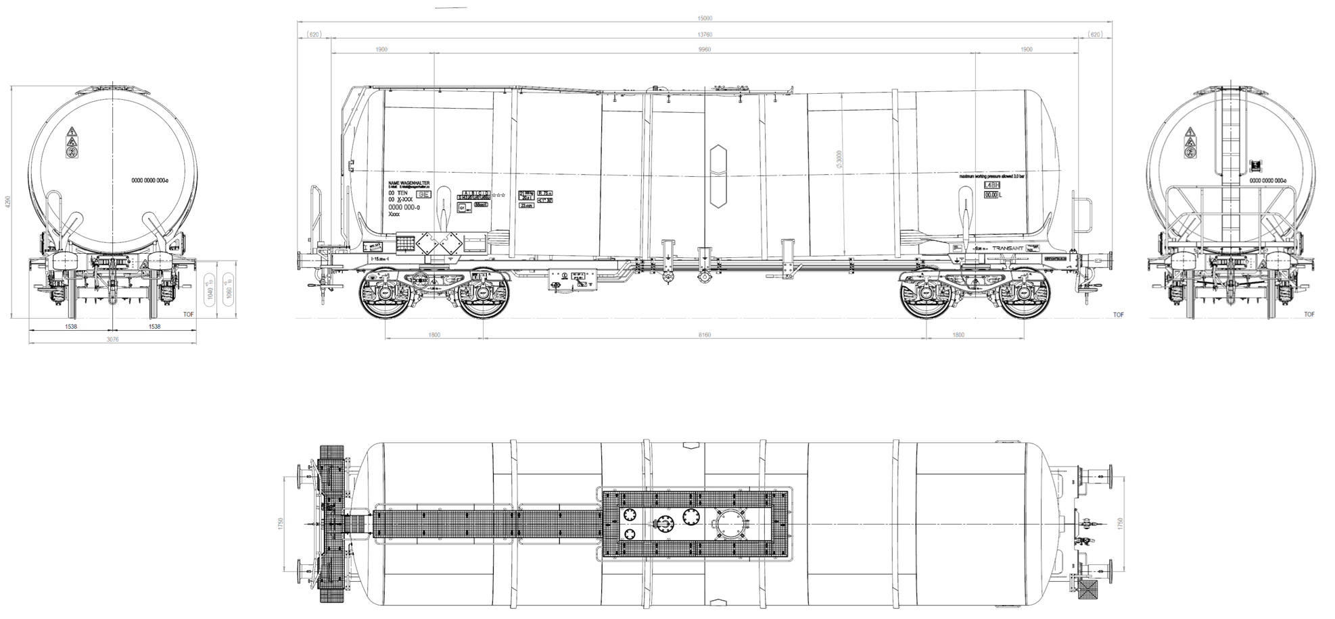
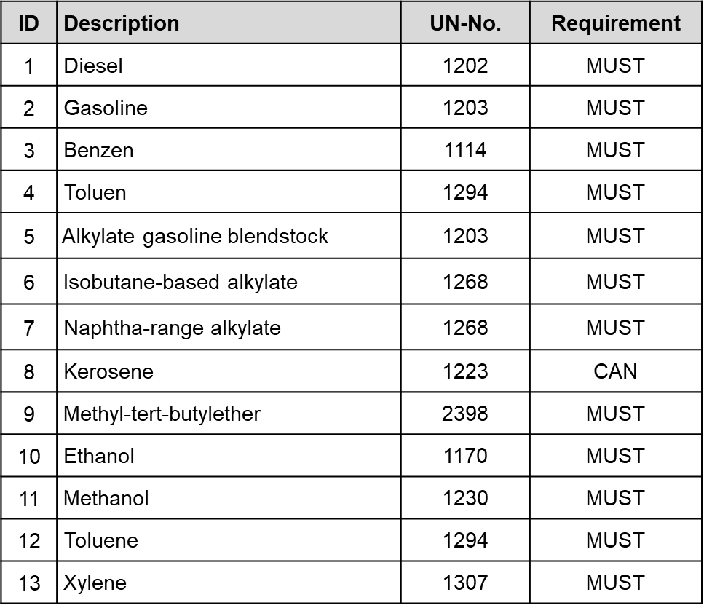
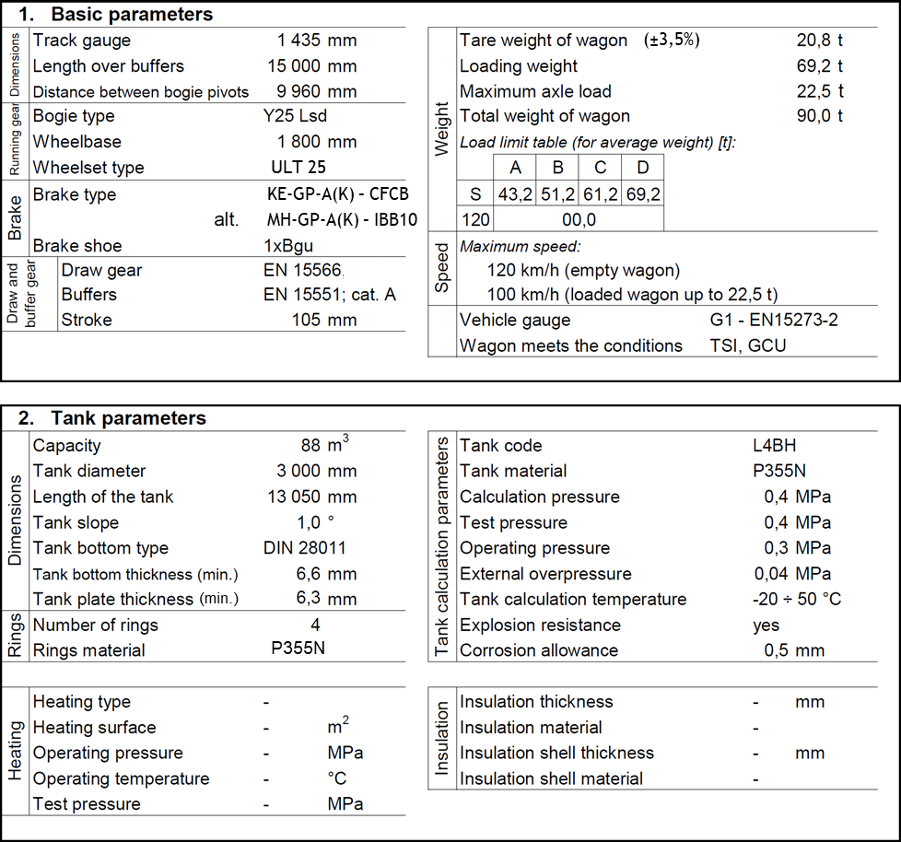
TransANT UNO tank 88m³
transport goods

Slide 5
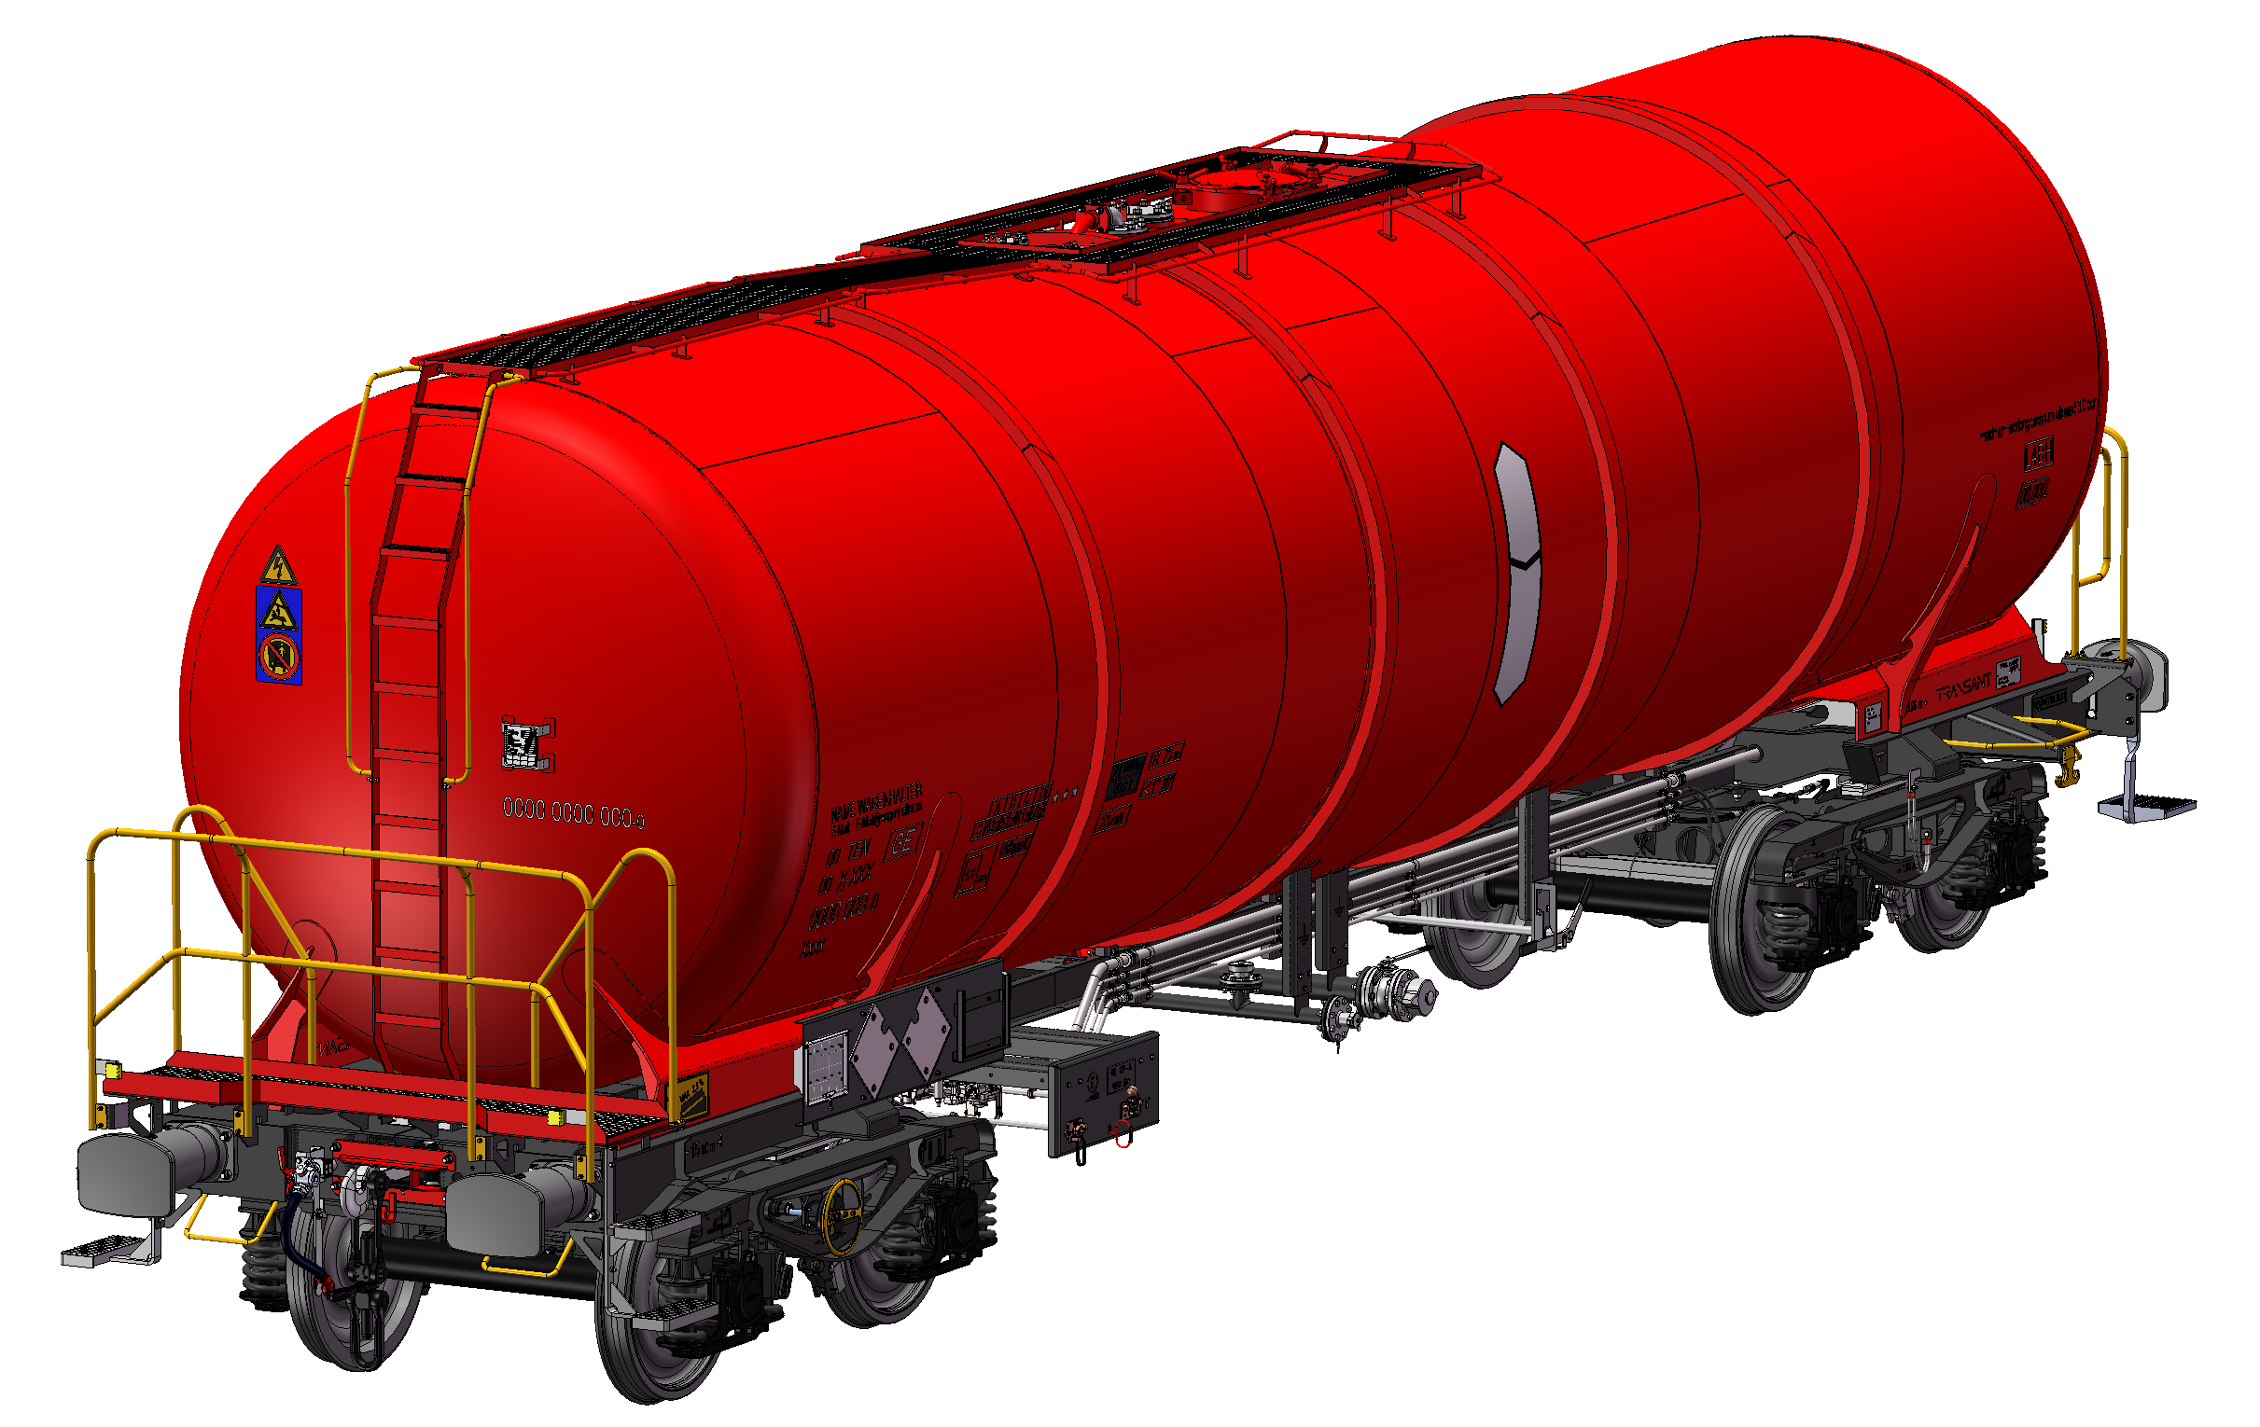
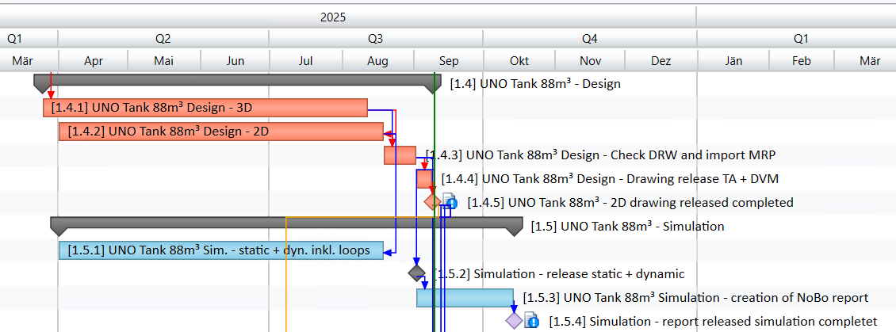
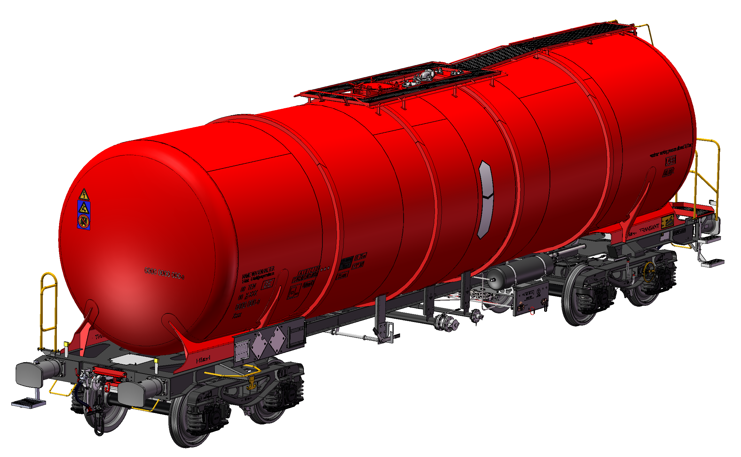
Current status - TransANT UNO tank 88m³
3D model and 2D drawings finished
3D model and 2D drawings submitted to Poltavvagon
Calculation finished (static + dynamic)
waiting for feedback from Poltavvagon to start drawing release process

Slide 6
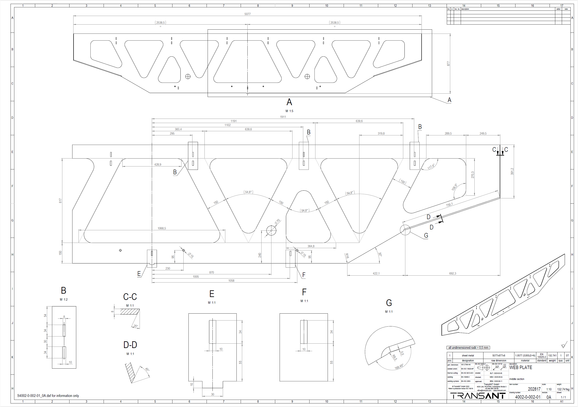
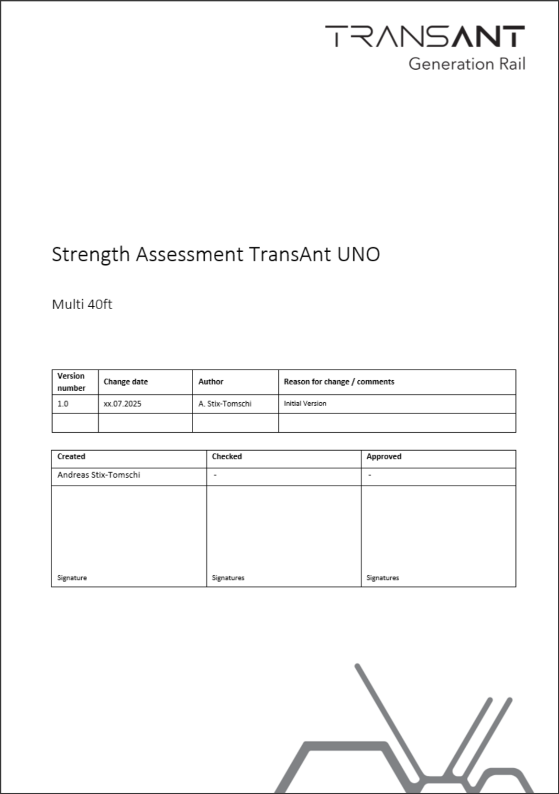
Next steps - TransANT UNO Multi 40ft
Approval of drawing set
Approval of strength report (TransANT)

Slide 7
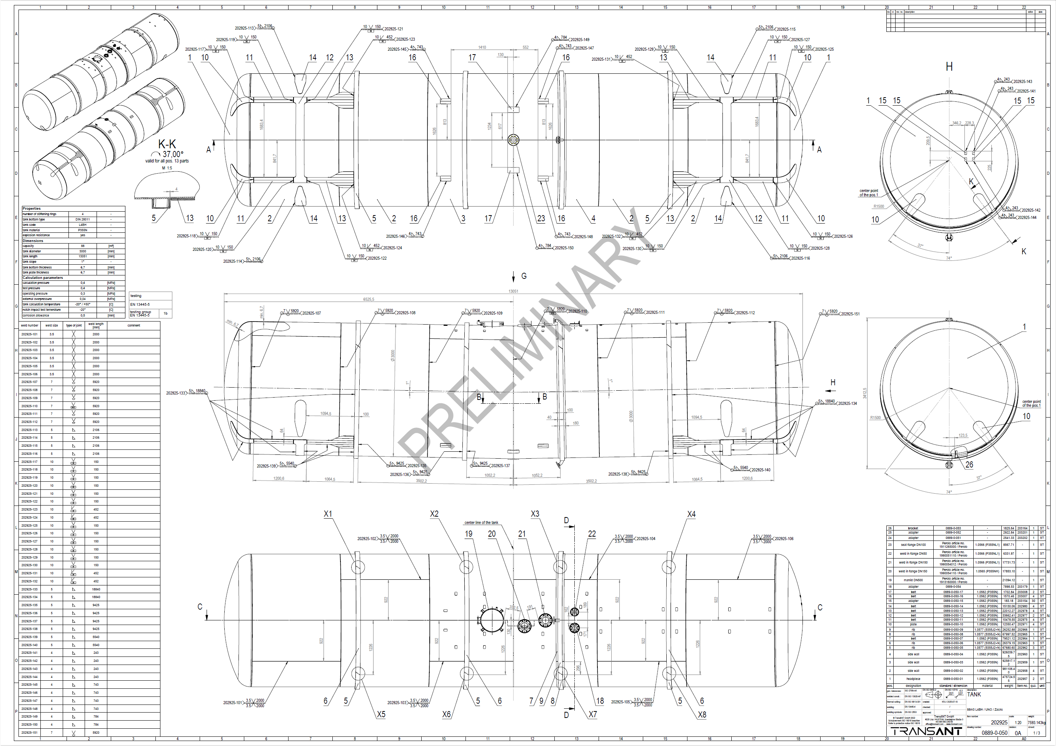
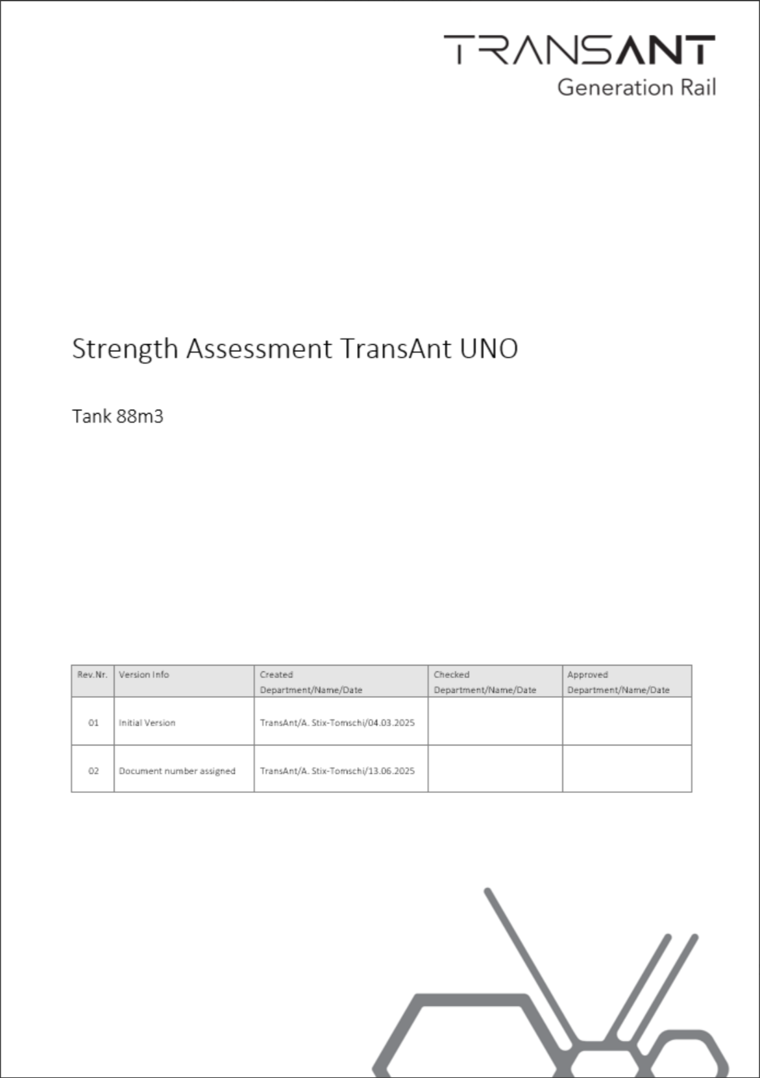
Next steps - TransANT UNO tank 88m³
Releasing of 3D model and 2D drawings
Finalization of calculation report

Slide 8
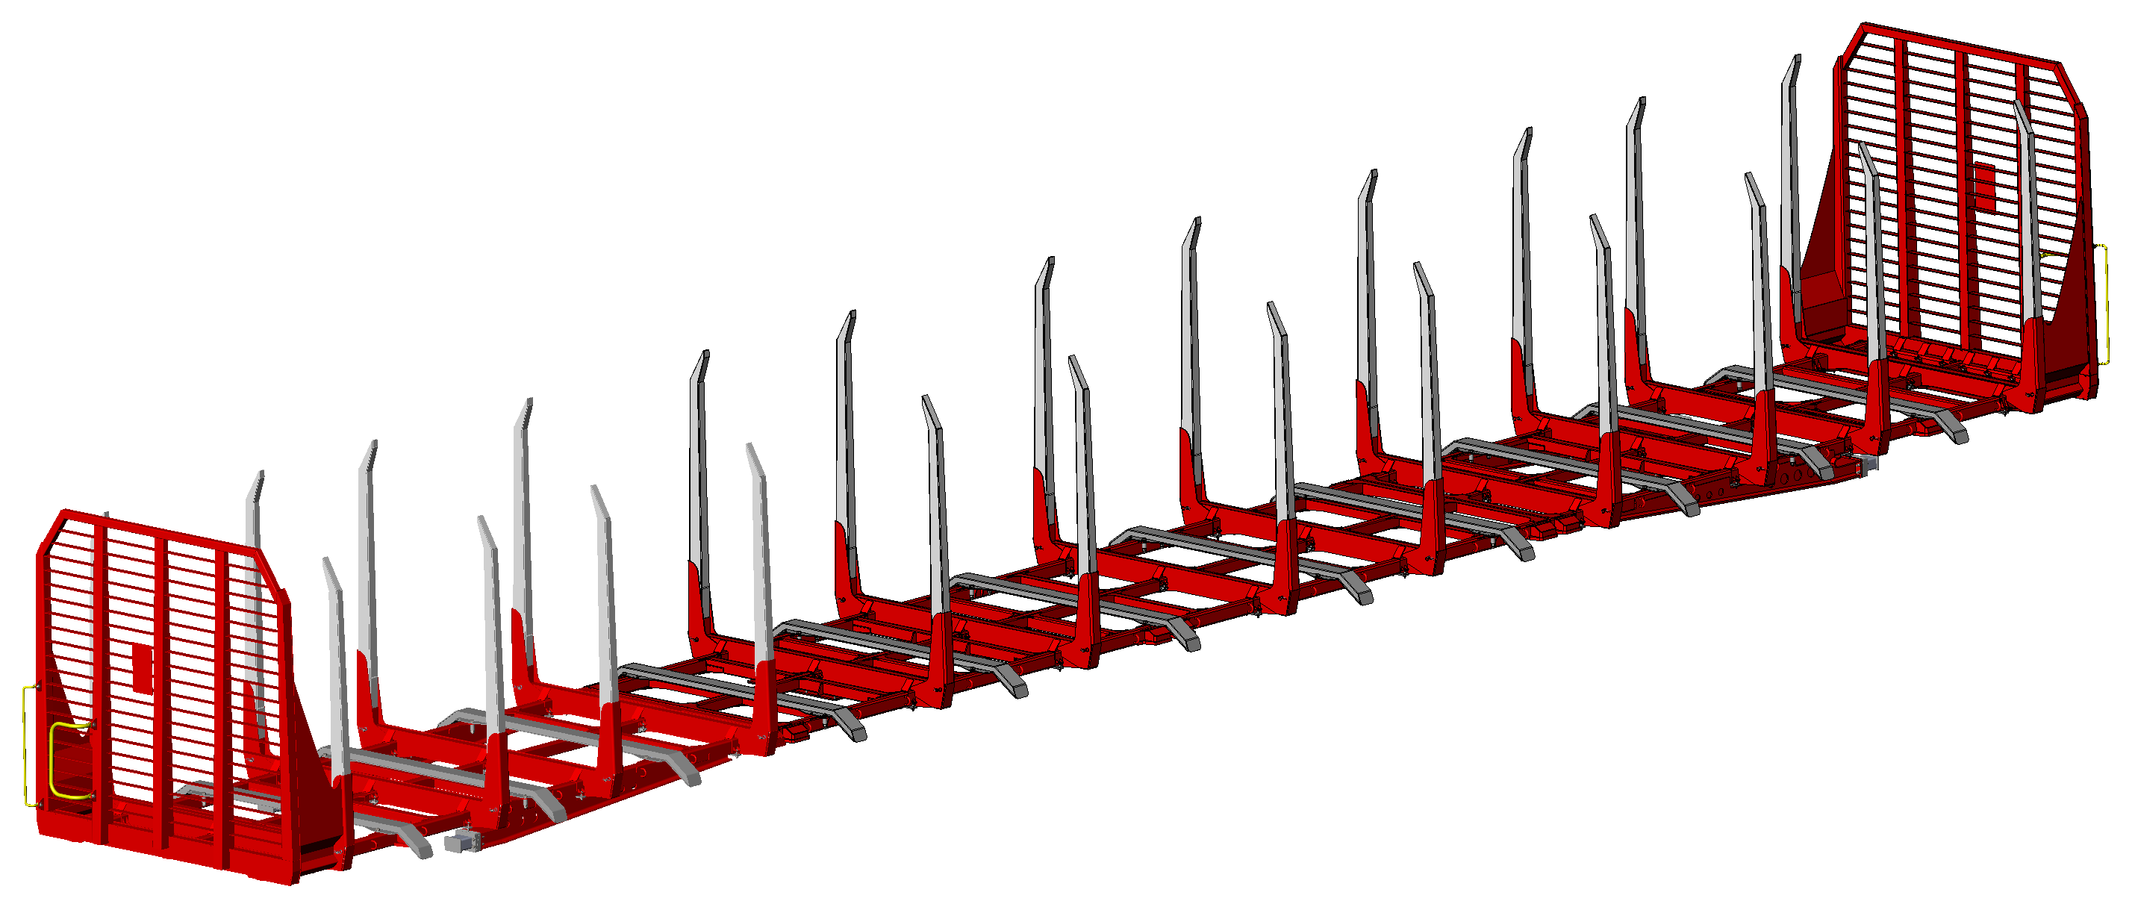
Next steps - generally
Reworking of the drawing set for the 70ft TimberTop for RCA
→ finished End of September
Reworking of the drawings of the hole portfolio in regard of surface treatment
→ finished End of September

Slide 9
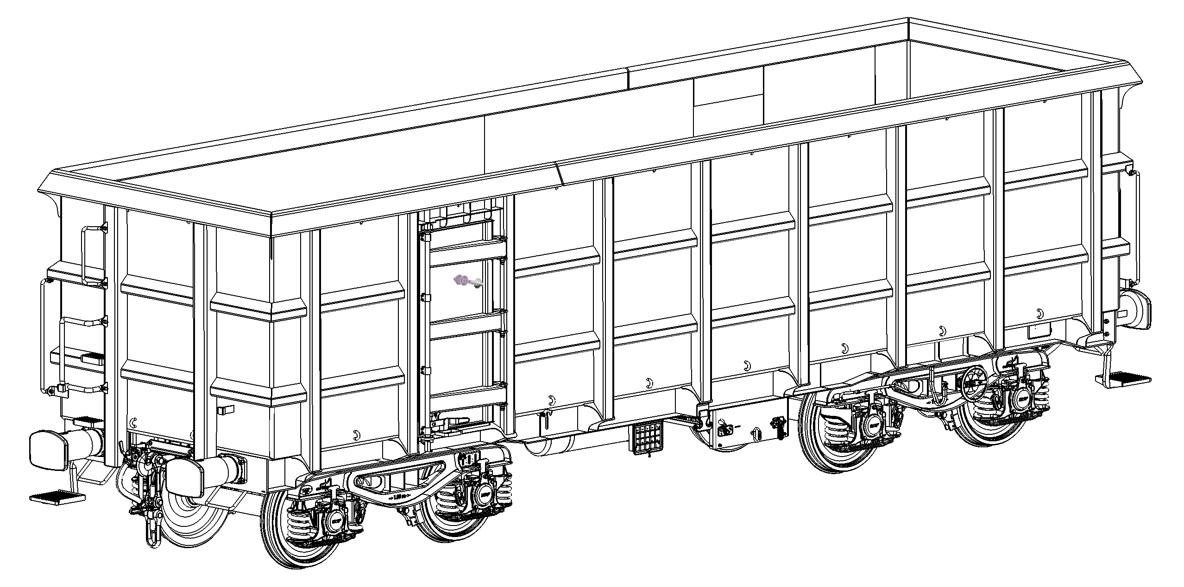
Next steps - projects
development of the shortest possible open top wagon
→ most versatile wagon for transporting very heavy goods
→ target 1.5t lighter than 33ft DB MultiTop
Possible finish date of drawing set → End of 2025

